Slide 1

Custom soldering and 3D printing
By Seilou bah

Slide 2
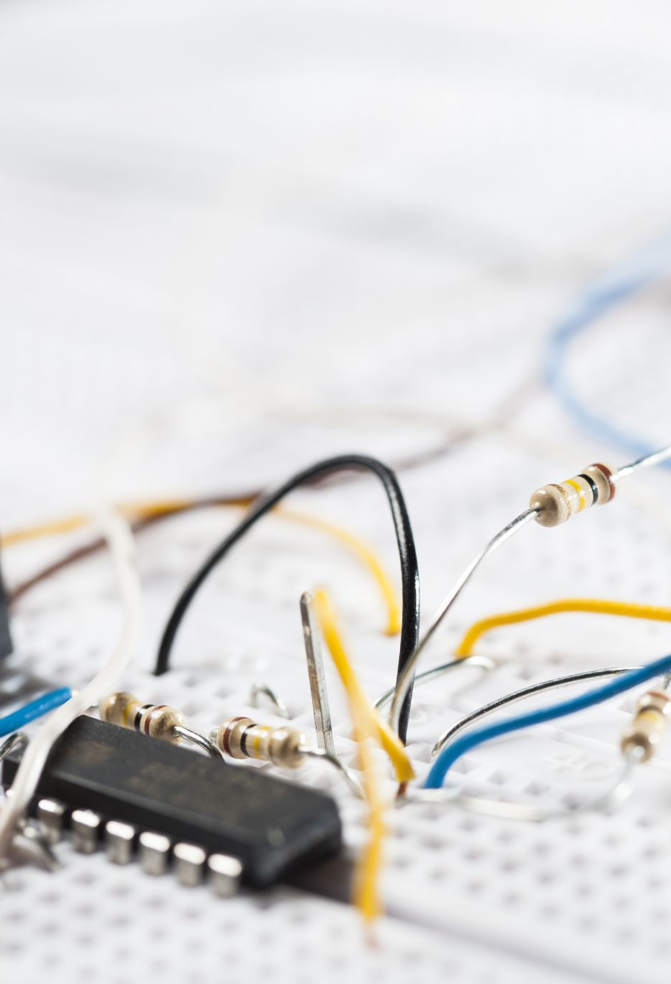
introduction
Custom soldering station consisting of bespoke PCB and an enclosure
3D printed enclosure with laser-etched acrylic panels
Adjust iron’s tip temperature and displays it on a 7-segment display
Main purposes: heating and melting solder wire for connecting components

Slide 3
Material and methods
PCB design using Altium Designer software
Component selection and footprint creation
PCB production by JLC
SMD component placement and reflow soldering
Acrylic panels designed with Laserworks
3D design with fusion 360
Makerspace facility for tools and machinery

Slide 4
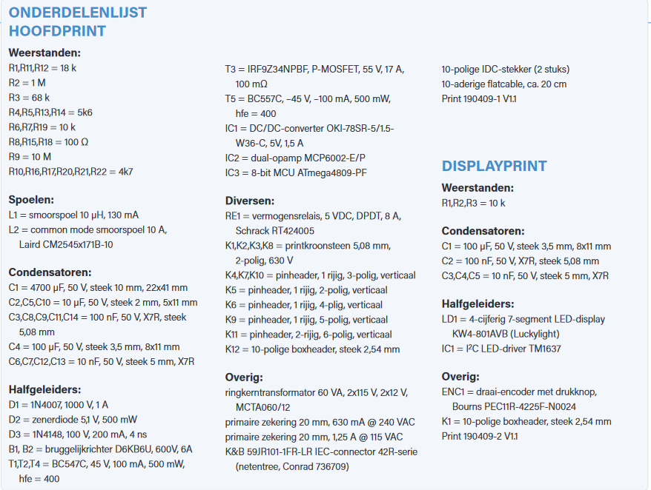
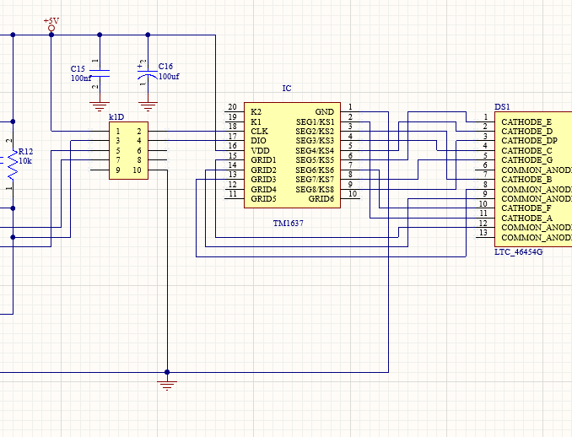
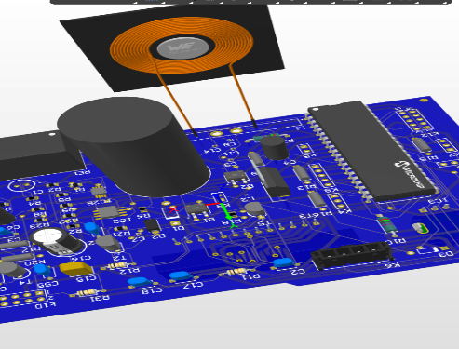
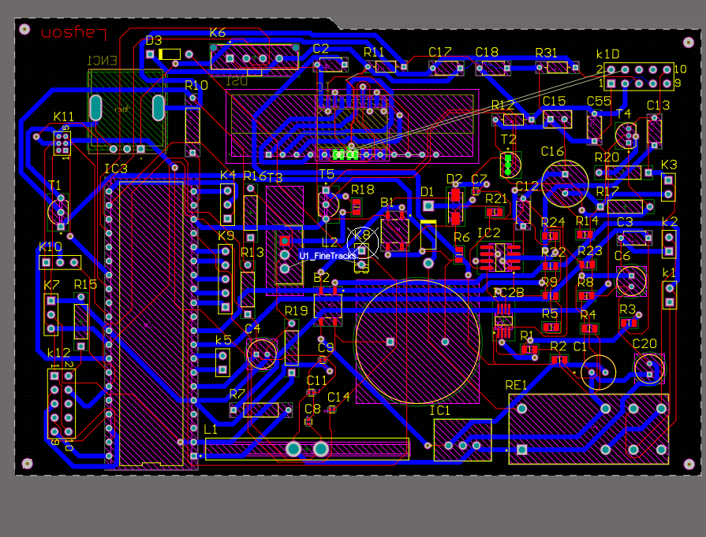
Photos

Slide 5

result
Startup menu: Select soldering iron type and configure settings
Temperature adjustment: Use rotation sensor to adjust temperature
Soldering: Apply solder to joints using the iron
Power-off and storage: Turn off and cool down iron before storing

Slide 6

discussion
Challenges during project planning
Difficulty finding necessary parts in Altium Designer
Confusion in purchasing components due to multiple versions
Suggestions for improvement: pre-purchasing components, checking availability, accurate component calculation, creating a custom library

Slide 7

Thank you
Do you have any queqstion

